Slide 1
Introduction of BJT:
A bipolar junction transistor is a type of transistor that relies on the contact of two types of semiconductor for its operation. The name bipolar is adopted from its structure whereby it has ‘two junction’ and consist of three doped region.
BJTs can be used as amplifiers, switches, or in oscillators.
BJT consists of three terminal:
collector : C
base : B
emitter : E
Two types of BJT : pnp and npn

Slide 2
Transistor Construction
•
3 layer semiconductor device consisting:
2 n- and 1 p-type layers of material ◊ npn transistor
2 p- and 1 n-type layers of material ◊pnp transistor
The term bipolar reflects the fact that holes and electrons participate in the injection process into the oppositely polarized material
A single pn junction has two different types of bias:
forward bias
reverse bias
Thus, a two-pn-junction device has four types of bias.

Slide 3
Common-Base Configuration
Common-base terminology is derived from the fact that the
:
- base is common to both input and output of the configuration.
- base is usually the terminal closest to or at ground potential.
All current directions will refer to conventional (hole) flow and the arrows in all electronic symbols have a direction defined by this convention.
Note that the applied biasing (voltage sources) are such as to establish current in the direction indicated for each branch.

Slide 4
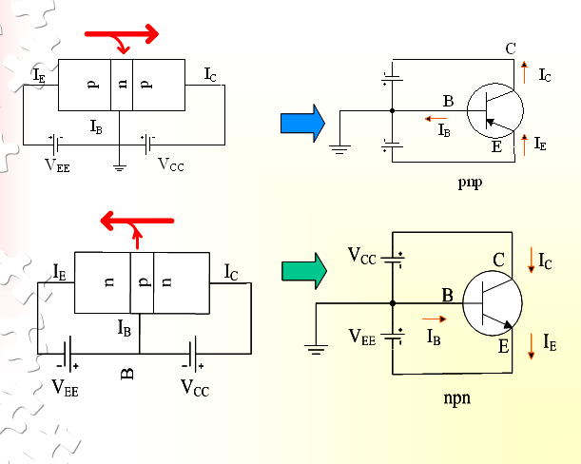

Slide 5
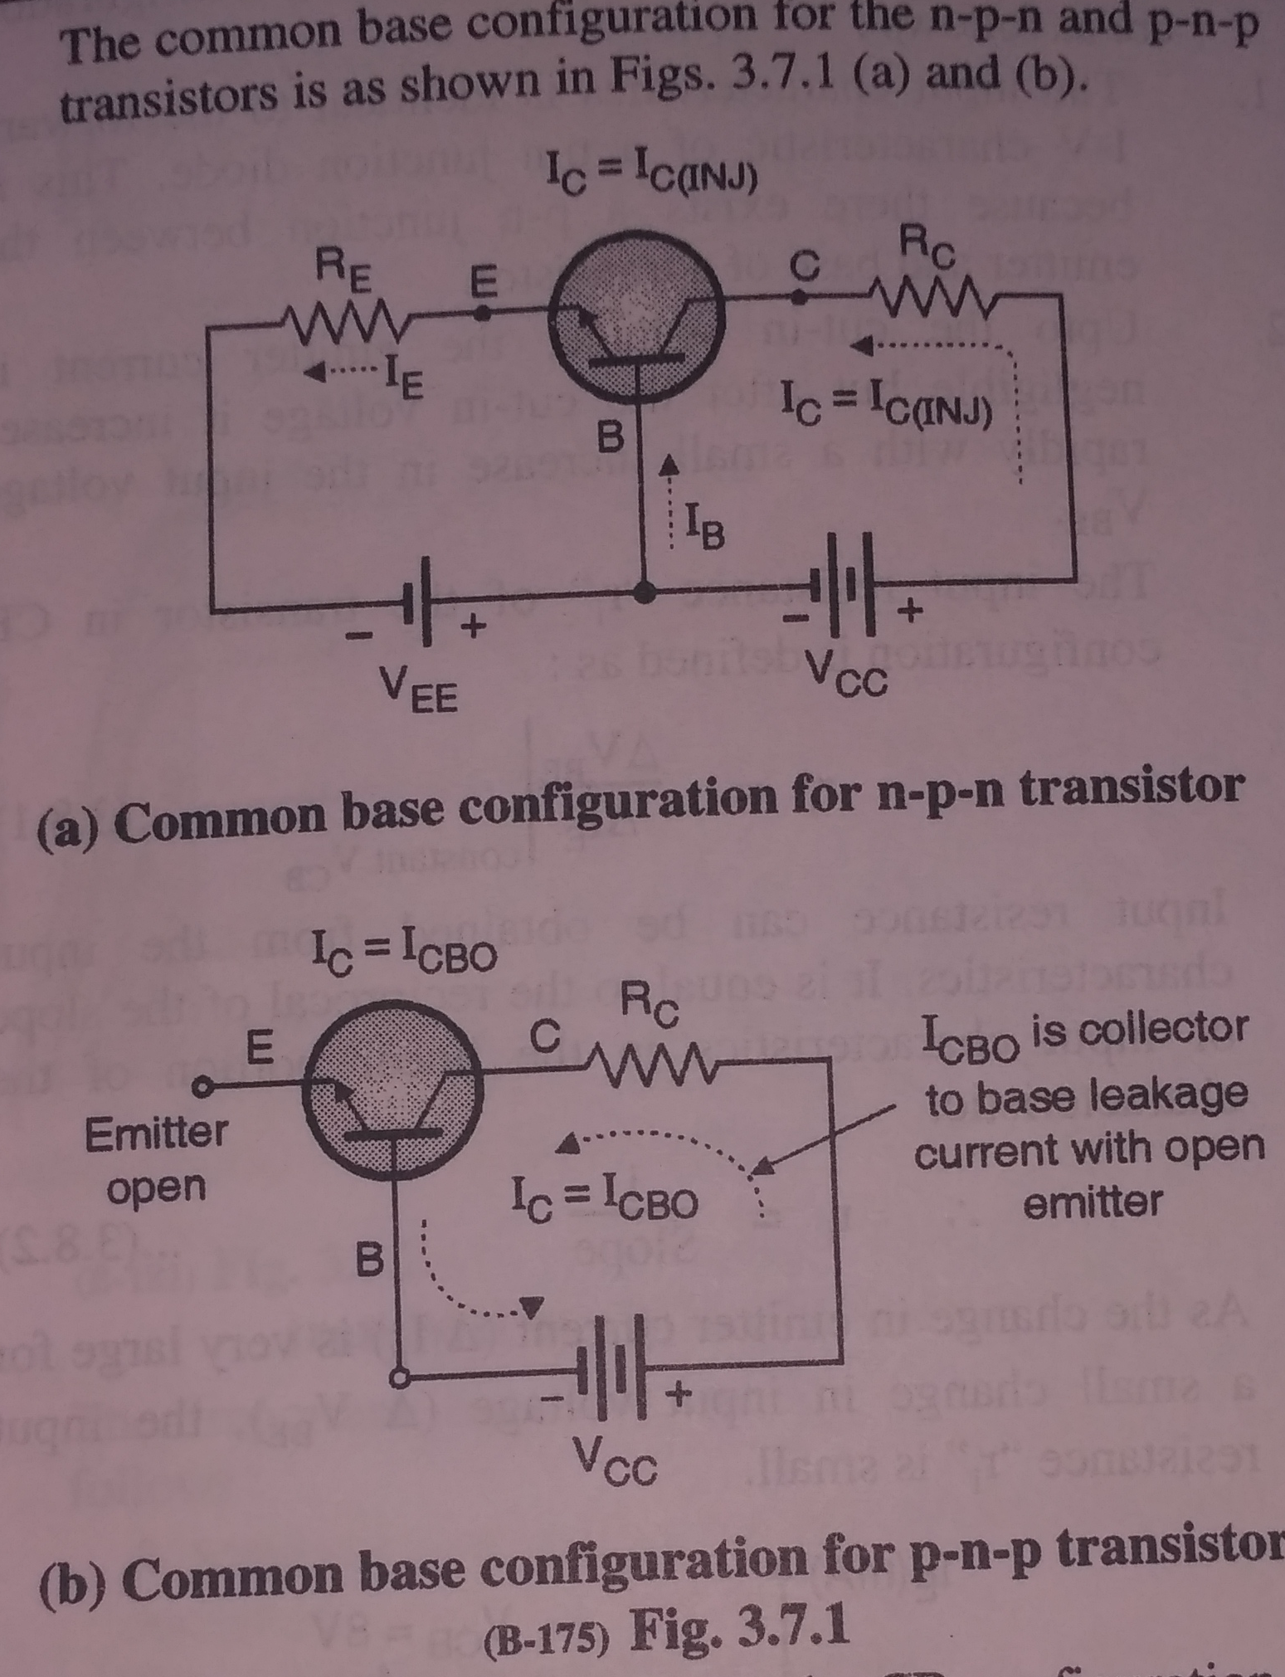

Slide 6
Configurations | Common base
Phase Angle | Zero (0°)
Input terminal | Emitter
Output terminal | Collector
Voltage gain | High
Current gain | Low (ratio of collector current & emitter current)
Power gain | Low
Input impedence | Low
Output impedence | High

Slide 7
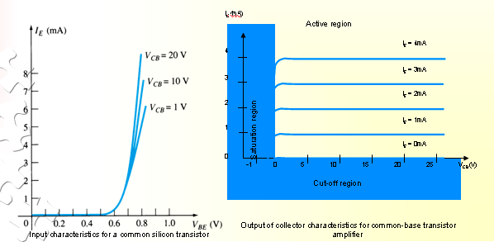
To describe the behavior of common-base amplifiers requires two set of characteristics:
Input or driving point characteristics.
Output or collector characteristics
The output characteristics has 3 basic regions:
- Active region –defined by the biasing arrangements
Cutoff region – region where the collector current is 0A
Saturation region- region of the characteristics to the left of V_{CB} = 0V

Slide 8
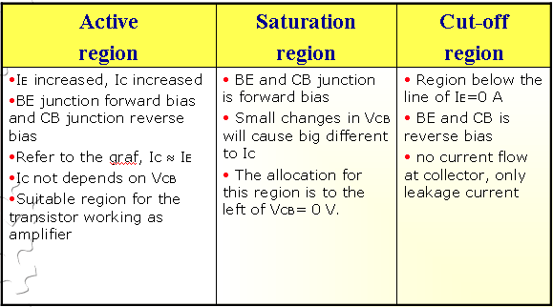

Slide 9
Alpha(α):
•
In the dc mode the level of I_{C} and I_{E} due to the majority carriers are related by a quantity called alpha
IC
α=
IE
So,
I_{C} = αI_{E}
For ac situations where the point of operation moves on the characteristics curve, an ac alpha defined by
_{α =} ΔIC
ΔIE
Alpha a common base current gain factor that shows the efficiency by calculating the current percent from current flow from emitter to collector.The value of α is typical from 0.9 ~ 0.998.

Slide 10
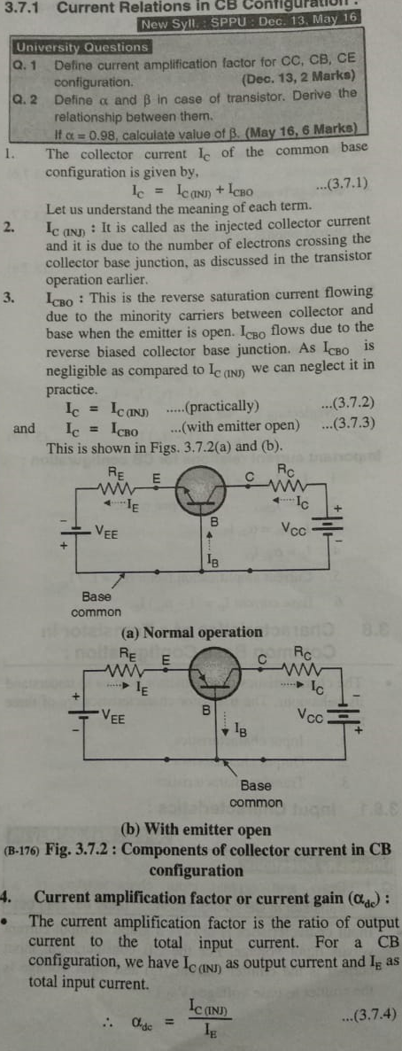

Slide 11
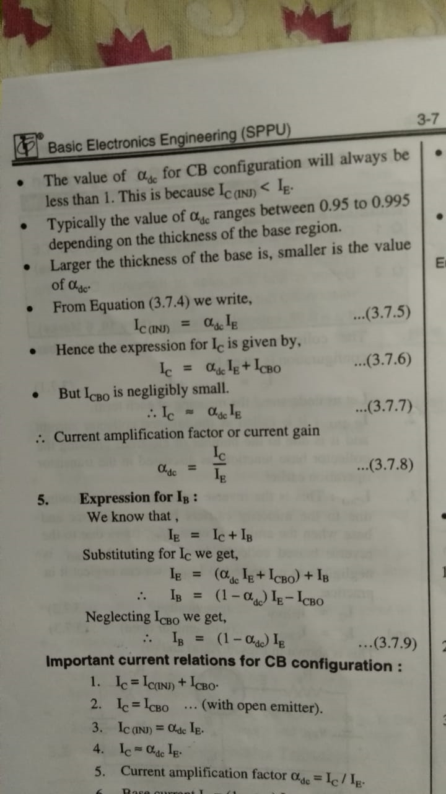

Slide 12
Common-Emitter Configuration
It is called common-emitter configuration since :
emitter is common or reference to both input and output terminals.
emitter is usually the terminal closest to or at ground potential.
Almost amplifier design is using connection of CE due to the high gain for current and voltage.
Two set of characteristics are necessary to describe the behavior for CE ;input (base terminal) and output (collector terminal) parameters.

Slide 13
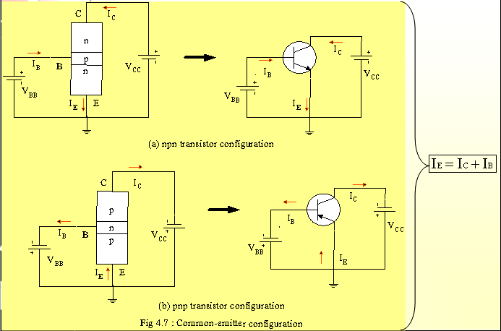
Proper Biasing common-emitter configuration in active region

Slide 14
Configurations | Common emitter
Phase Angle | 180°
Input terminal | Base
Output terminal | Collector
Voltage gain | Medium
Current gain | Medium(ratio of Collector current & base current)
Power gain | High
Input impedence | Medium
Output impedence | High

Slide 15
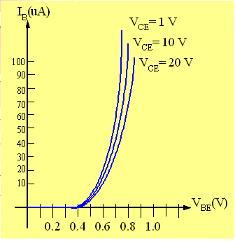
I_{B} is microamperes compared to miliamperes of I_{C}.
•
•
I_{B} will flow when V_{BE} > 0.7V
for silicon and 0.3V for germanium
Before this value I_{B} is very small and no I_{B}.
Base-emitter junction is forward bias
Increasing V_{CE} will reduce I_{B} for different values.
•
•
Input characteristics for a common-emitter NPN transistor

Slide 16
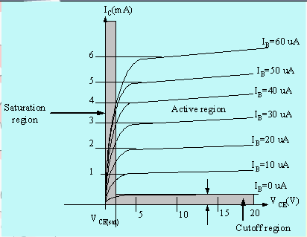
Output characteristics
for a common-emitter npn
transistor:
•
•
•
For small V_{CE} (V_{CE} < V_{CESAT}, I_{C} increase linearly with increasing of V_{CE} V_{CE} > V_{CESAT} I_{C} not totally depends on V_{CE} ◊ constant I_{C}
I_{B}(uA) is very small compare to I_{C} (mA). Small increase in I_{B} cause big increase in I_{C}
I_{B}=0 A ◊ I_{CEO} occur.
Noticing the value when I_{C}=0A. There is still some value of current flows.
•
•

Slide 17
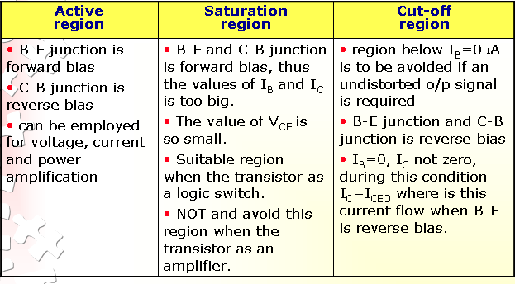

Slide 18
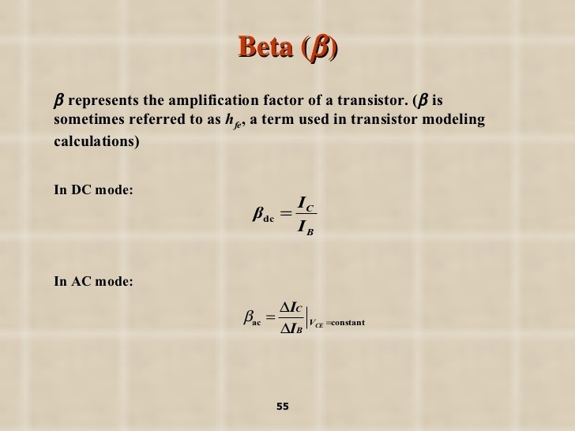

Slide 19
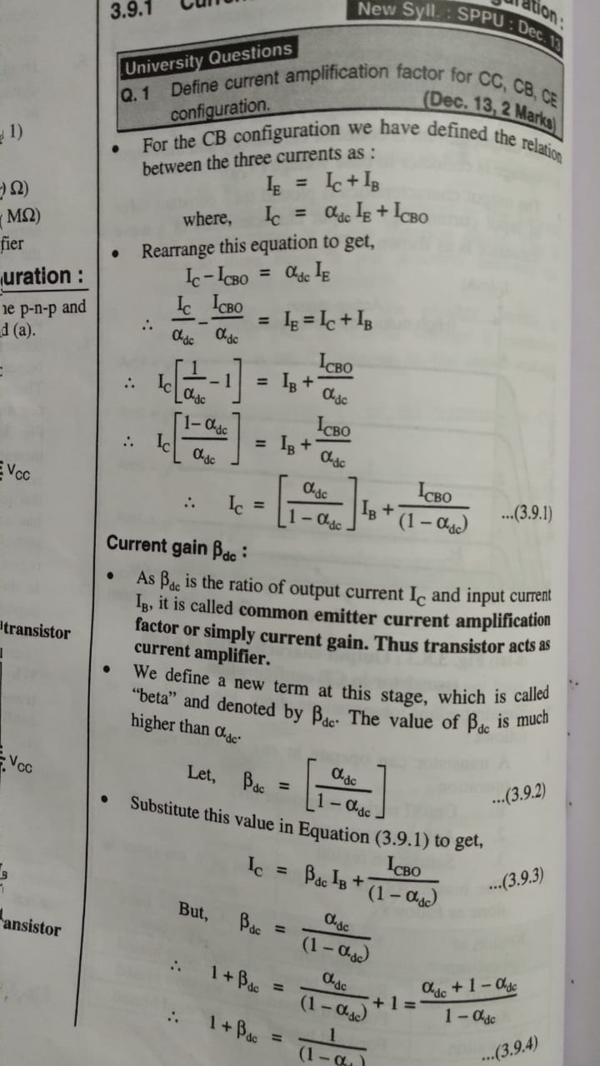

Slide 20
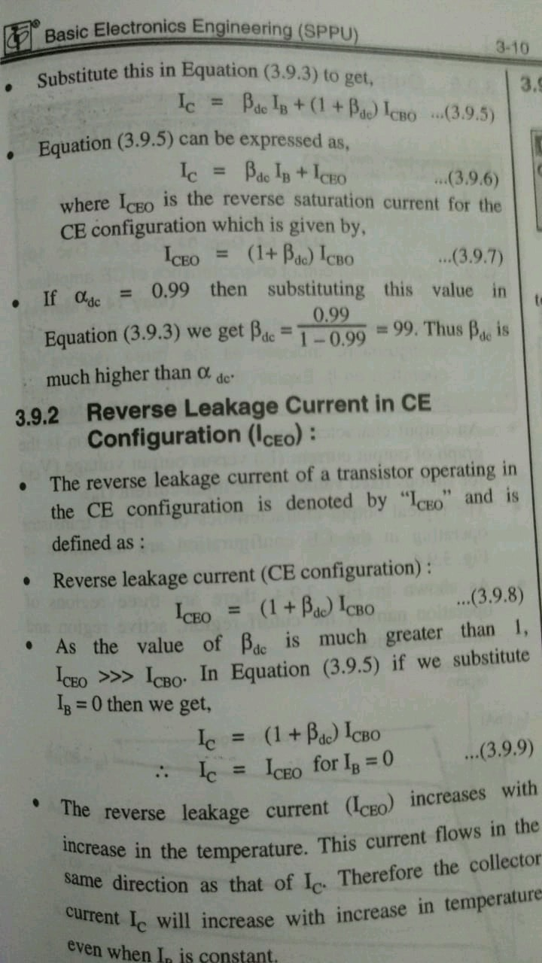

Slide 21
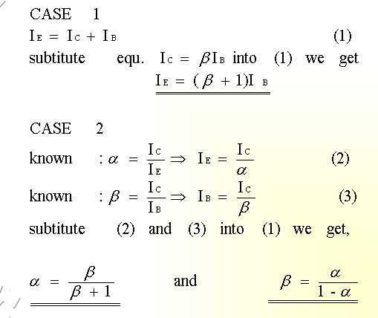
Relationship analysis between α and β

Slide 22
Common – Collector Configuration
Also called emitter-follower (EF).
It is called common-emitter configuration since both the
signal source and the load share the collector terminal as a common connection point.
The output voltage is obtained at emitter terminal.
The input characteristic of common-collector configuration is similar with common-emitter. configuration.
Common-collector circuit configuration is provided with the load resistor connected from emitter to ground.
It is used primarily for impedance-matching purpose since it has high input impedance and low output impedance.

Slide 23
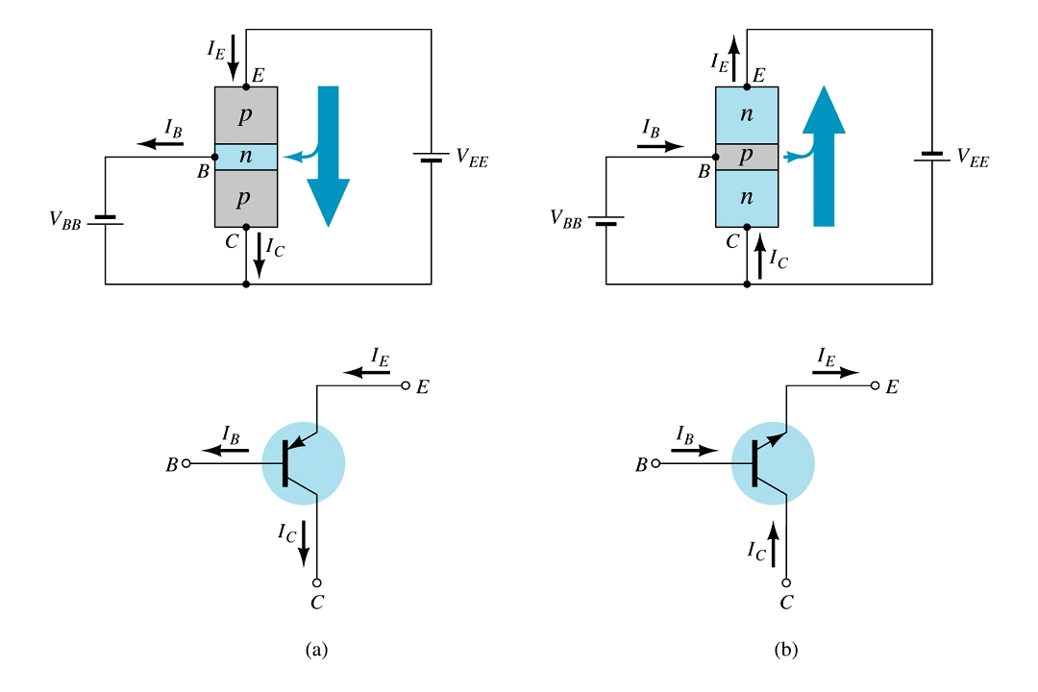
Notation and symbols used with the common-collector configuration:
(a) pnp transistor ; (b) npn transistor.

Slide 24
Characteristics of Common Collector:
Configurations | Common collector
Phase Angle | Zero(0)
Input terminal | Base
Output terminal | Emitter
Voltage gain | Low
Current gain | High(ratio of emitter current and base current)
Power gain | Medium
Input impedence | High
Output impedence | Low

Slide 25
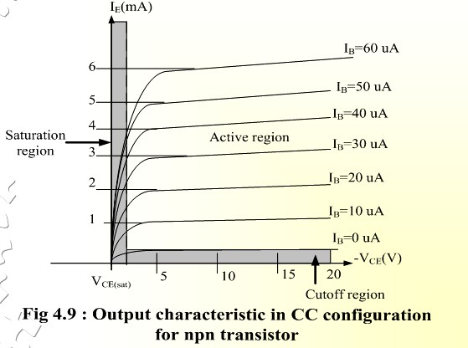

Slide 26


